Slide 1
Career Plan 12 Student Guide
Resume
Job Application

Slide 2
The Basics
All Seniors must complete the Resume Requirement.
All Seniors must complete a Job Application.
The Resume will be created in Naviance:
OPTION 1: under the “About Me” tab
OPTION 2: upload a document in the “Journal” tab
The Job Application will be uploaded to Naviance in the “Journal” tab.
Forum Mentor teachers will check completion by the assigned due date of October 26, 2018.
Career Plan credit (0.25) is required for graduation.

Slide 3
Step One: Create Resume in Naviance

Slide 4
Step One: Create Resume in Naviance
You have two options for creating your resume:
OPTION 1 –Create it directly in Naviance
OPTION 2—Create it in Word (or another file format) and upload it to the Journal Tab in Naviance

Slide 5
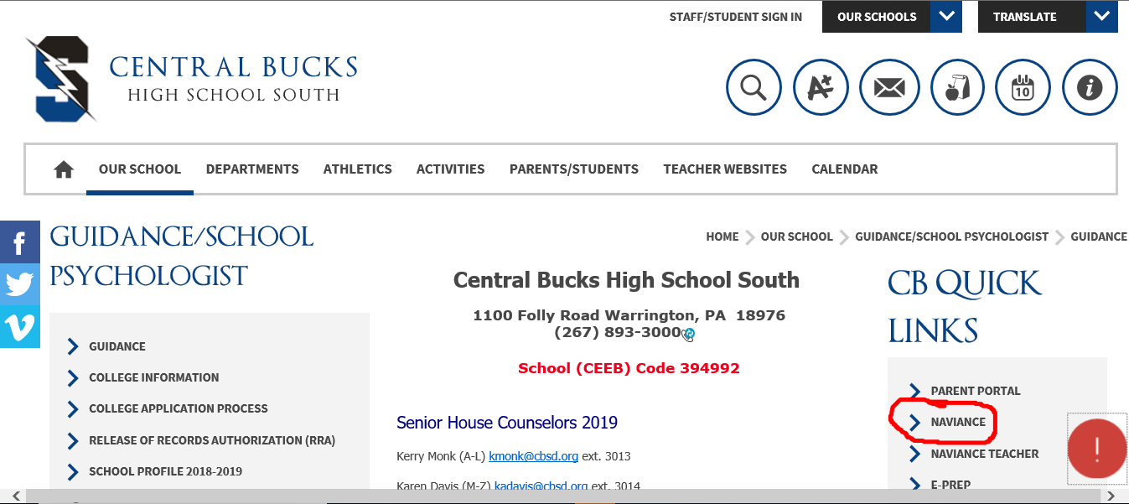
Go to CB webpage; click on Naviance
Logging on to Naviance…

Slide 6
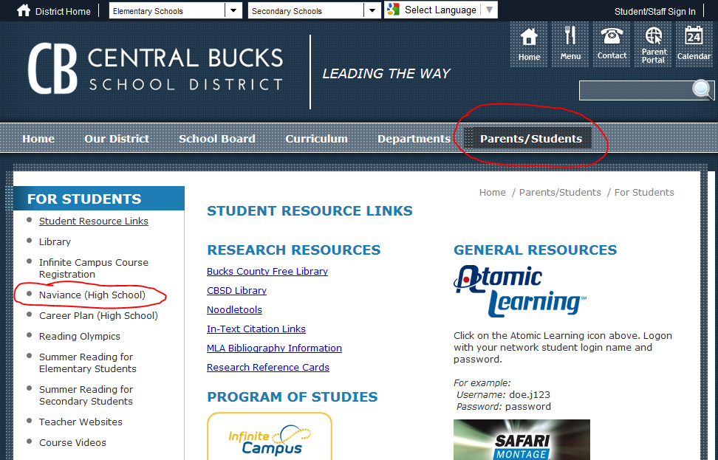
Logging on to Naviance…
Go to CBSD webpage

Slide 7
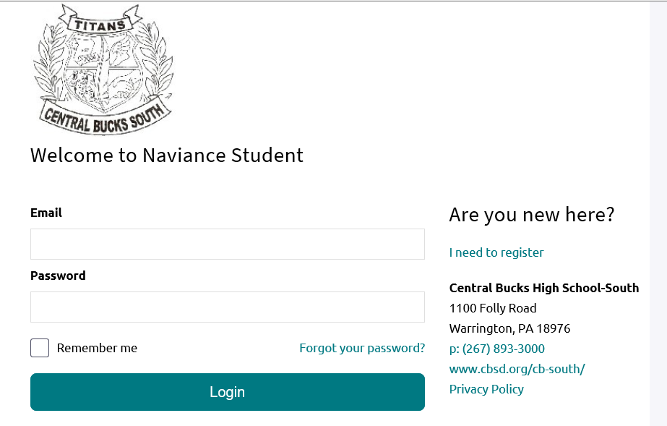
Go to email / password boxes
NOTE: IF YOU HAVE FORGOTTEN YOUR PASSWORD OR HAVE CHANGED YOUR EMAIL, PLEASE SEE MS. SCHAMP IN THE GUIDANCE OFFICE.

Slide 8
Click on Log In

Slide 9
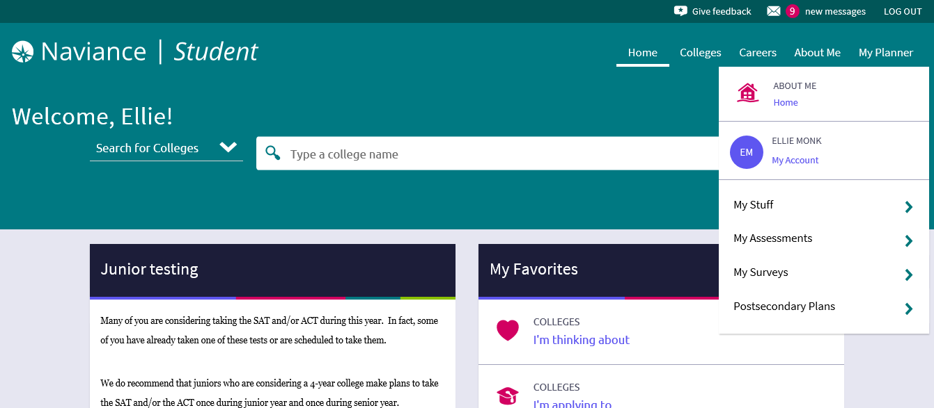
OPTION 1--Click on “About Me” tab, then “My Stuff” menu, then “Resume”

Slide 10
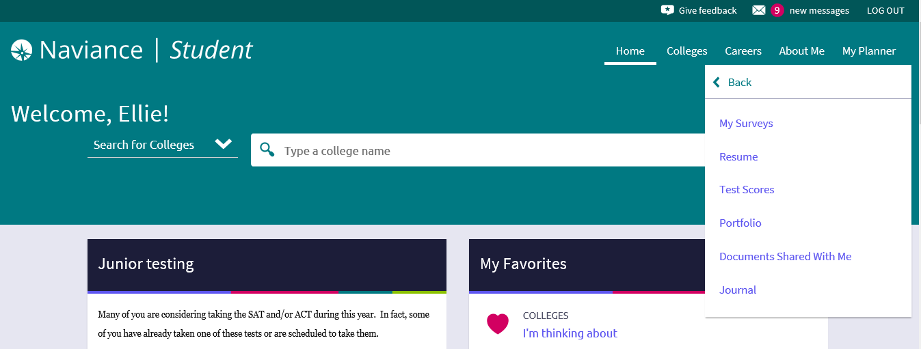
OPTION 1--Click on “Resume”

Slide 11
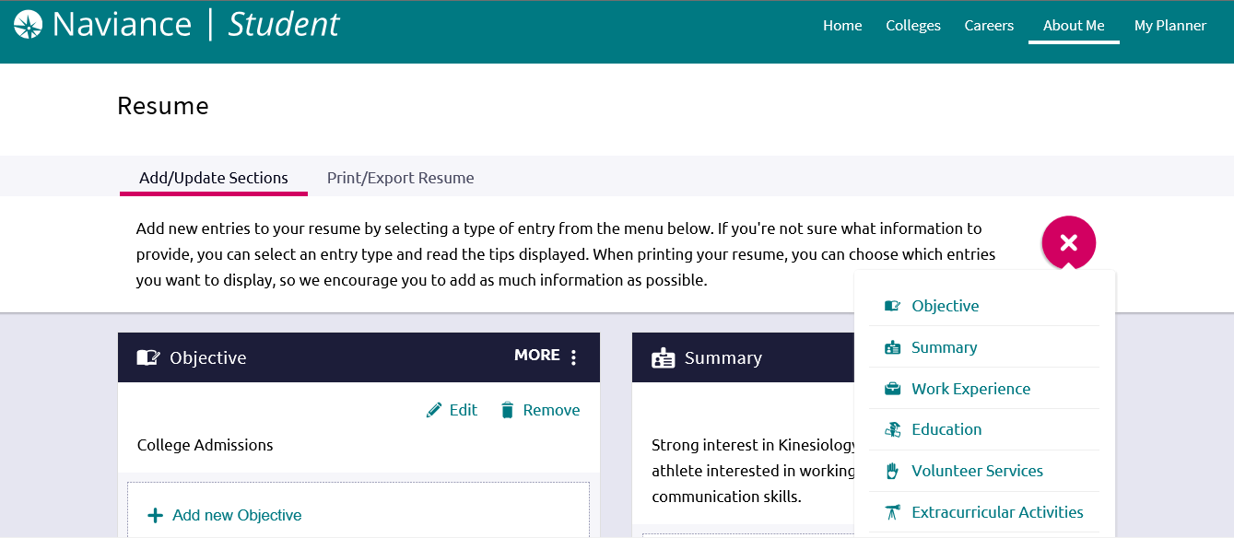
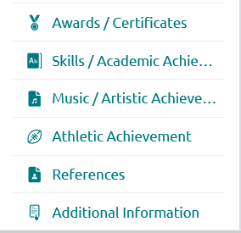
OPTION 1--From the drop down, you MUST complete entries for: OBJECTIVE, EDUCATION, and REFERENCES

Slide 12
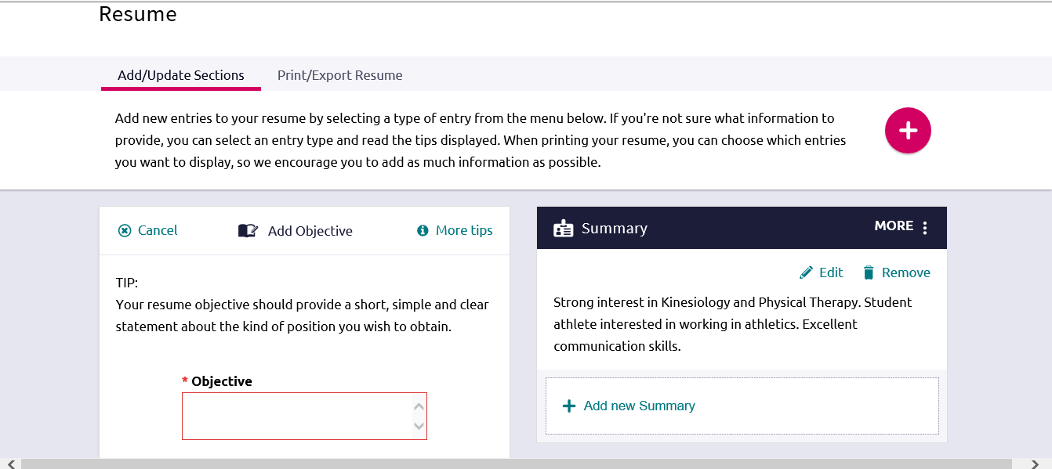
OPTION 1--Using OBJECTIVE as an example, enter the requested information in the box

Slide 13
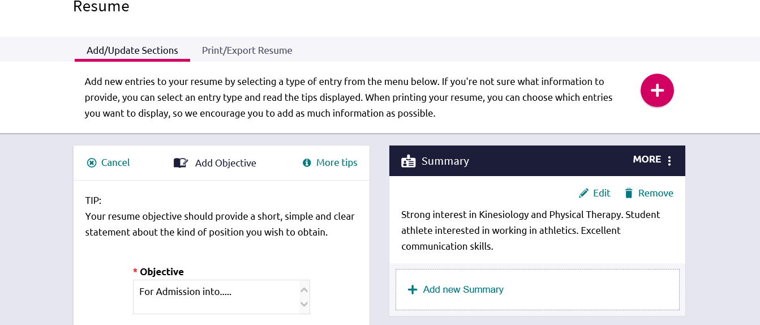
OPTION 1--After you enter the information in the box, you will be able to see your entry on your resume.

Slide 14
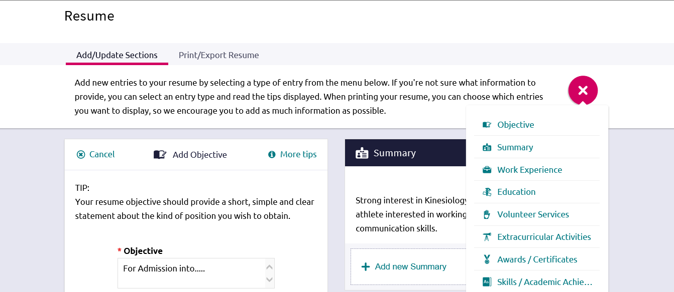
OPTION 1--In addition to the required entries , you must complete two additional entries

Slide 15
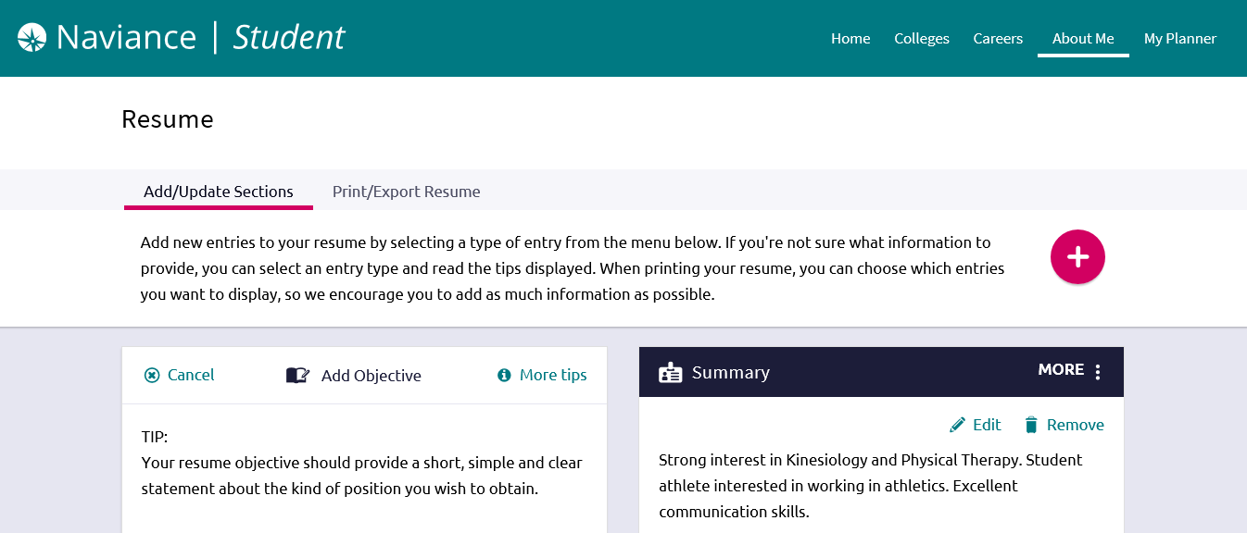
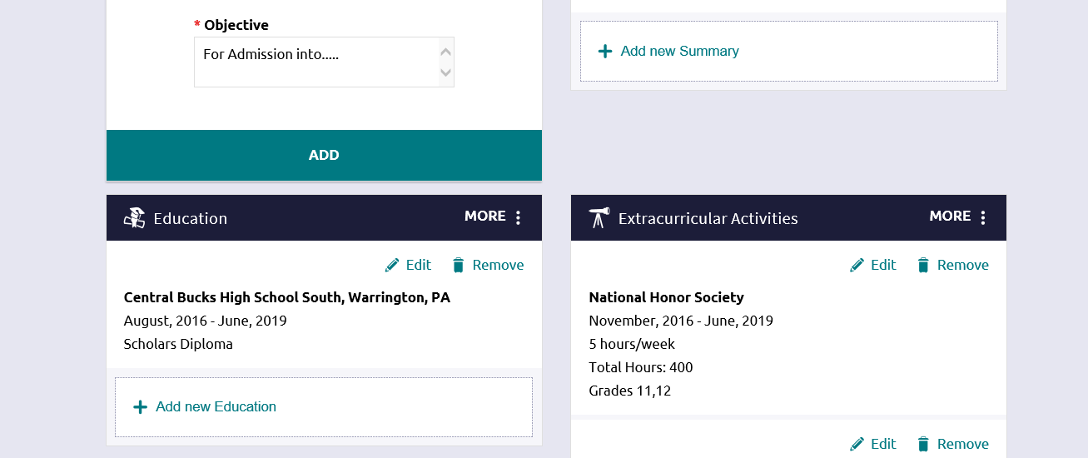
OPTION 1--Your resume will begin to take shape…

Slide 16
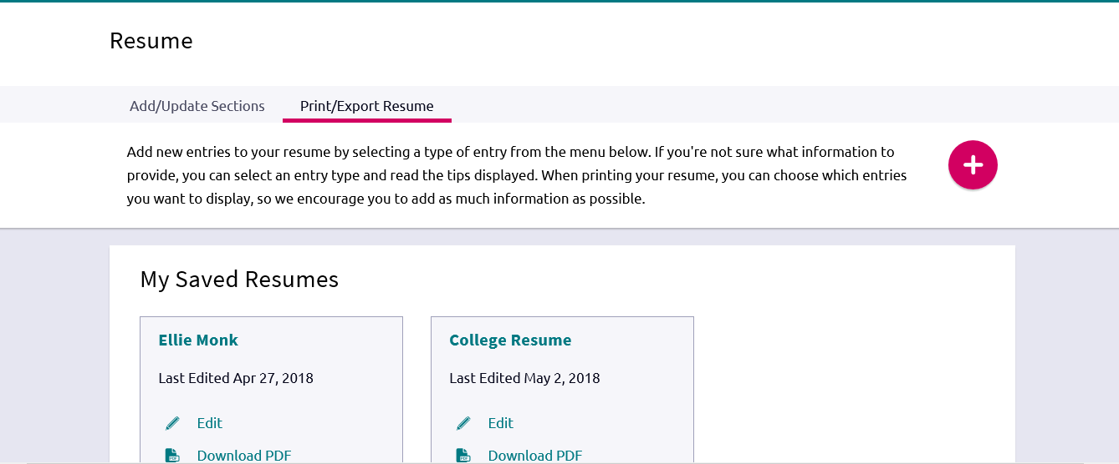
OPTION 1--After you’ve completed the entries, you can choose to print your resume through Print/Export Resume tab.

Slide 17
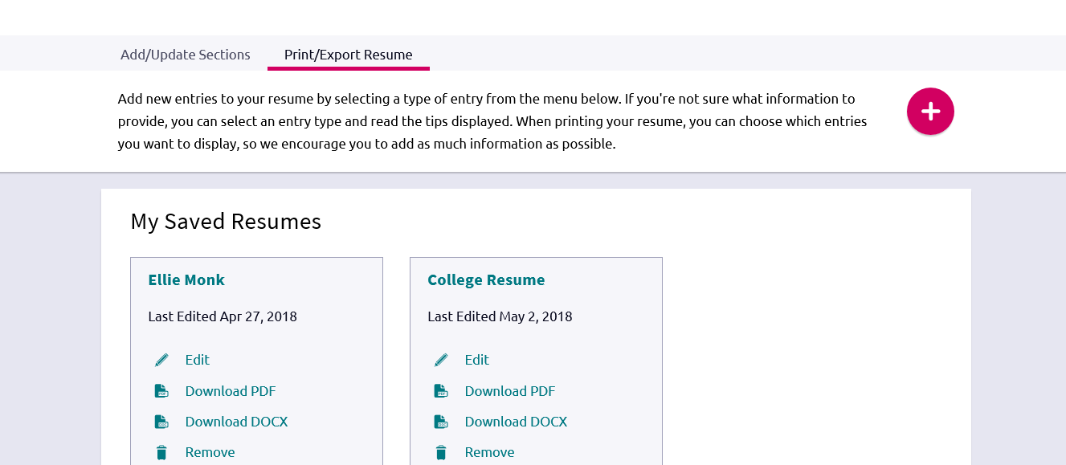
OPTION 1—Download Your Resume, and Save

Slide 18
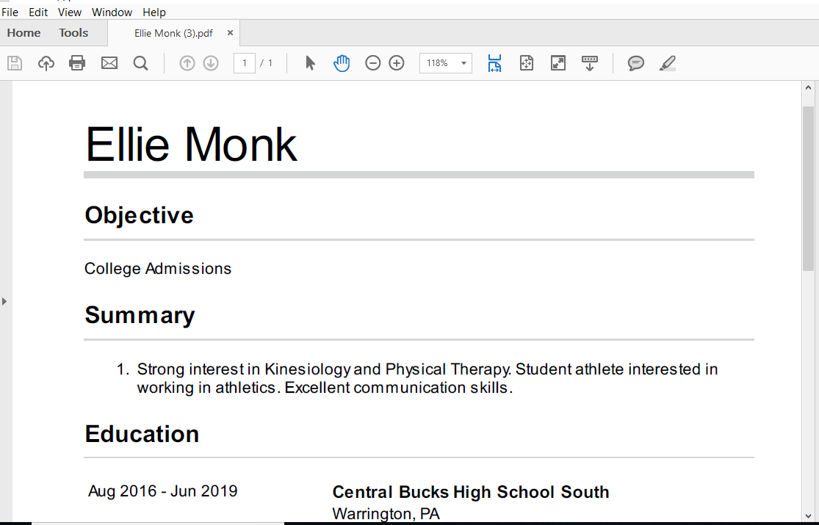
OPTION 1--Your resume is ready to be printed should you choose to do so. You are NOT required to print your resume.

Slide 19
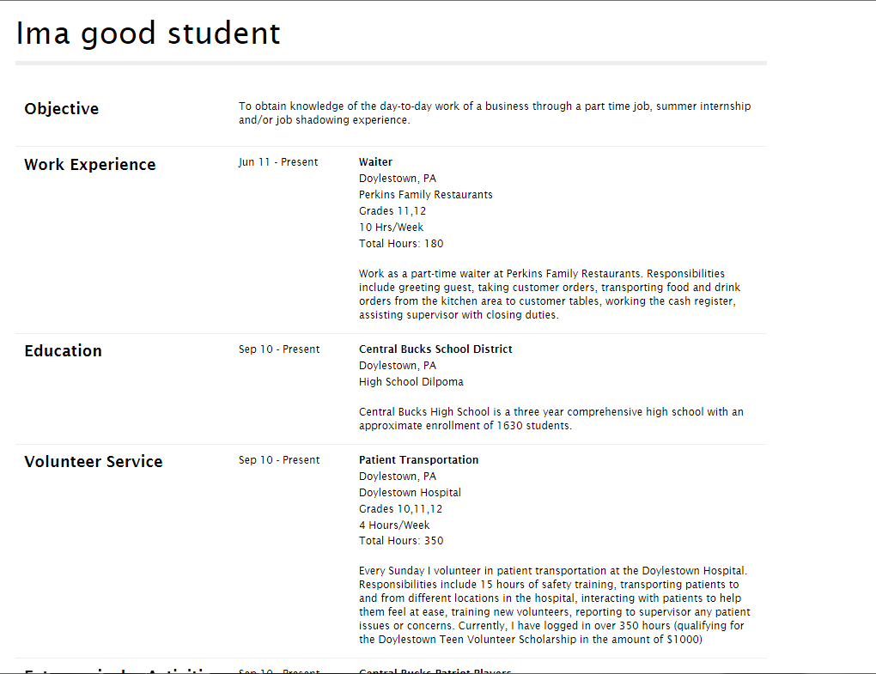
OPTION 1--This is an example of a completed resume

Slide 20
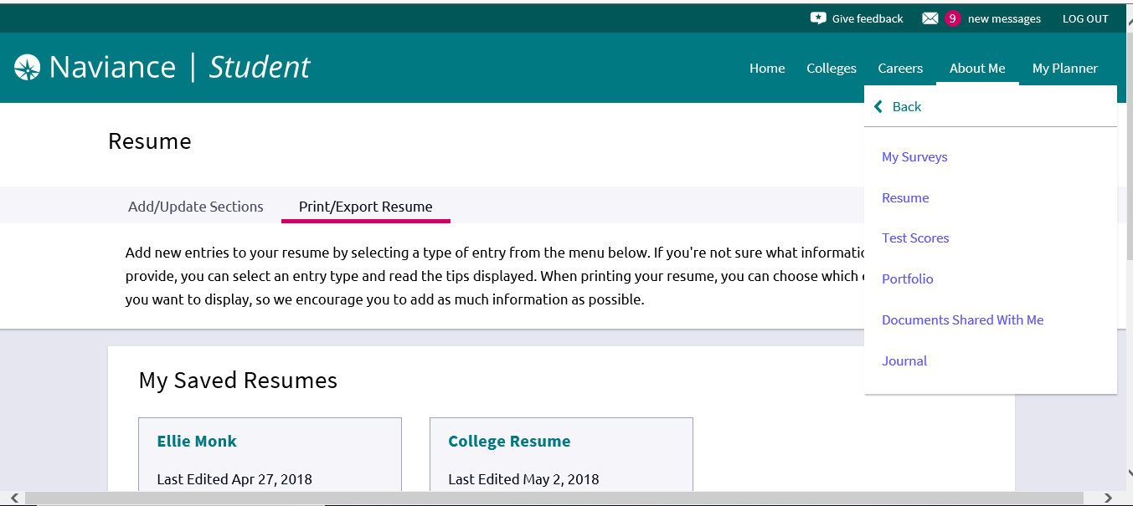
OPTION 2—Upload your resume in the Journal tab
Create your resume and save it as a PDF.
Upload it to the Journal tab

Slide 21
Add a Journal

Slide 22
Share with Counselors and Teachers (although you may share with parents if you like), and Find your Saved File, and click “Add”.

Slide 23
Step Two: Complete Job Application

Slide 24
1. Download job application template.
Go to the CB home page (www.cbsd.org)
Click on “Teaching and Learning”
Click on “Assessment”
Click “Career Plan”. This takes you to Career Plan Webpage.
Or… Go to- https://www.cbsd.org/Page/289
Click on “Career Plan 12 Job Application”
Fill out, save as your own Word Document
Upload on “Journal Tab” in Naviance

Slide 25
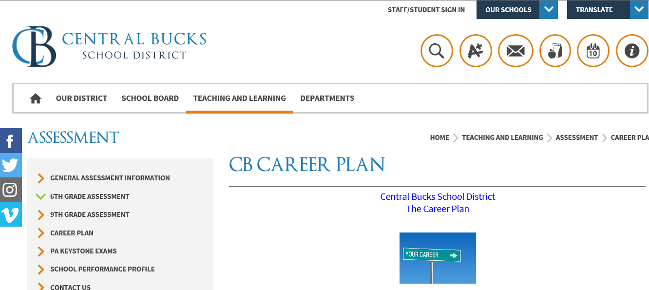
Click on Career Plan from the CBSD Assessment Page

Slide 26
Click on Career Plan 12 Job Application template

Slide 27
Fill out application, and save as Word Document
Add to Journal tab in Naviance

Slide 28
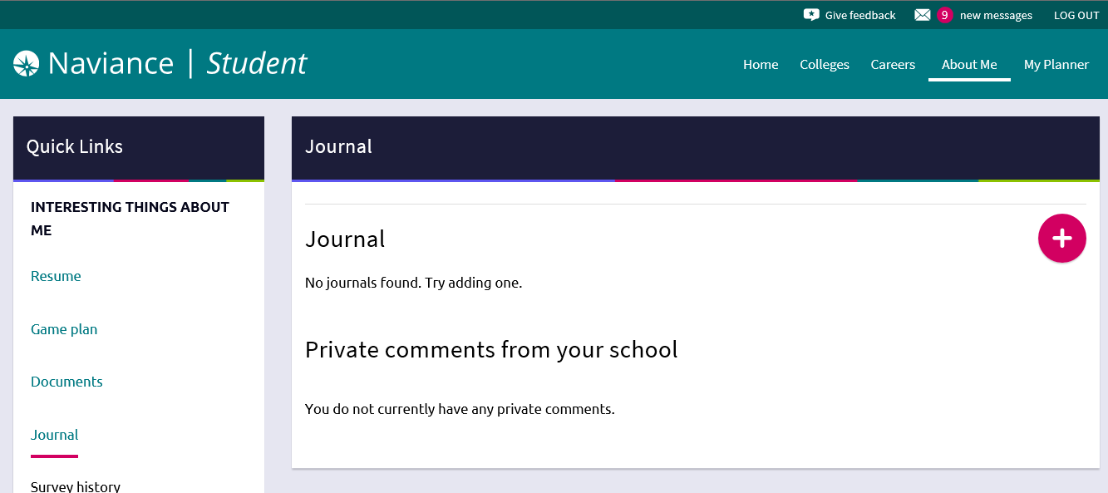
Add a Journal

Slide 29
Share with Counselors and Teachers (although you may share with parents if you like), and Find your Saved File, and click “Add”.

Slide 30
Due Dates
Resume (Added as a Journal in Naviance)—due Wednesday, October 26
Job application (Added as a Journal Tab on Naviance)—due Wednesday, October 26
Uploads will be checked in forum

Slide 31
For Your Reference
This Power Point Presentation is also available on the Class of 2019 webpage:
https://www.cbsd.org/Page/42521

